Slide 1
AGGRESSIVE PERIODONTITIS
RUNGTA COLLEGE OF DENTAL SCIENCES AND RESEARCH,BHILAI
PRESENTED BY:
Dr Sonika Bodhi
Reader
Dept. of Periodontology

Slide 2
SPECIFIC LEARNING OBJECTIVES
CORE AREAS | DOMAIN | CATEGORY
Introduction | Affective | Desire to know
Historical background | Cognitive | Nice to know
Definition | Cognitive | Must to know
Classification | Cognitive | Must to know
Clinical features, radiologic features, prevalence | Cognitive | Must to know
Etiopathogenesis | Cognitive | Must to know
Treatment | Pshycomotor | Nice to know

Slide 3
CONTENTS
Introduction
Historical background
Definition
Classification
Clinical features, radiologic features, prevalence
Etiopathogenesis
Treatment
Summary

Slide 4
INTRODUCTION
The 1999 International Workshop for the Classification of the Periodontal Diseases organized by the AAP classified periodontitis into following categories:
Chronic Periodontitis
Aggressive Periodontitis
Periodontitis as a Manifestation of Systemic Diseases.

Slide 5
AGGRESSIVE PERIODONTITIS
EARLY ONSET PERIODONTITIS
Localized Aggressive Periodontitis (LAP)
Generalised Aggressive Periodontitis (GAP)
Rapidly progressive Periodontitis (RPP)

Slide 6
HISTORICAL BACKGROUND
Gottlieb 1923……
Fatal case of epidemic influenza & disease that he called Diffuse Atrophy of the Alveolar Bone
Clinical features..
Loss of collagen fibers of periodontal ligament
Replacement by loose connective tissue
Extensive bone resorption
Widened periodontal ligament space.
Gingiva apparently not involved.

Slide 7
HISTORICAL BACKGROUND
Gottlieb 1928…….
Attributed this condition to the inhibition of continuous deposition of cementum…essential for maintenance of the pdl fibers.
Deep Cementopathia…….disease of eruption
Wannenmacher 1938……
Described the incisor-first molar involvement…
‘parodontitis marginalis progressiva’ .

Slide 8
HISTORICAL BACKGROUND
Thoma & Goldman 1940….
‘paradontosis’
Initial abnormality was located in the alveolar bone rather than cementum.
Orban & Weinmann 1942…
‘periodontosis’

Slide 9
HISTORICAL BACKGROUND
Goldman 1947…..
Attributed it to a degenerative non-inflammatory disease of the supporting structures.
World Workshop in Periodontics 1966…..
Concept of periodontosis as a degenerative entity was unsubstantiated & that the term should be eliminated from the periodontal nomenclature.

Slide 10
HISTORICAL BACKGROUND
Chaput and colleagues in 1967 and by Butler in 1969 ........“Juvenile periodontitis”
In 1989, the World Workshop in Clinical Periodontics categorized this disease as Localized juvenile periodontitis (LJP).
In 1999, according to the classification workshop of AAP, this term LJP has been renamed as Localized aggressive periodontitis.

Slide 11
DEFINITION
Baer (1971)
“disease of the periodontium occurring in an otherwise healthy adolescent which is characterized by a rapid loss of alveolar bone, about more than one tooth of the permanent dentition. The amount of destruction is not commensurate with the amounts of local irritants”

Slide 12
CLASSIFICATION
AGGRESSIVE PERIODONTITIS
LOCALIZED AGGRESSIVE PERIODONTITIS
GENERALISED AGGRESSIVE PERIODONTITIS

Slide 13
PRIMARY FEATURES
Non contributory medical history
Rapid attachment loss & bone destruction
Familial aggregation of cases.

Slide 14
SECONDARY FEATURES
Amounts of microbial deposits inconsistence with the severity of periodontal tissue destruction
Elevated levels or Aa & Pg in some populations.
Phagocyte abnormalities
Hyper-responsive macrophage phenotype, elevated levels of PgE2, IL-1β.
Progression of attachment loss & bone loss may be self arresting.

Slide 15
LOCALIZED AGGRESSIVE PERIODONTITIS
Circumpubertal onset of disease
Localized 1st molar /incisor disease with proximal attachment loss on atleast two permanent teeth one of which is a 1st molar
Robust serum antibody response to infecting agents

Slide 16
GENERALISED AGGRESSIVE PERIODONTITIS
Affecting persons under 30 years of age, but patients may be older
Generalised interproximal attachment loss affecting 3 teeth other than 1st molars & incisors
Pronounced episodic nature of periodontal destruction
Poor serum antibody response to the infecting agents

Slide 17
LOCALIZED AGGRESSIVE PERIODONTITIS
CLINICAL FEATURES...
Lack of clinical inflammation…
Presence of deep pockets..
Minimal plaque accumulation…less tendency to calcify...
Plaque with elevated levels of ....... A actinimycetemcomitans

Slide 18
LOCALIZED AGGRESSIVE PERIODONTITIS
CLINICAL FEATURES...
5. Distolabial migration of maxillary incisors with concomitant diastema formation.
6. Increasing mobility of maxillary & mandibular incisors & first molars.
7. Sensitivity of exposed root surface to thermal & tactile stimuli.
8. Deep dull radiating pain on mastication.

Slide 19
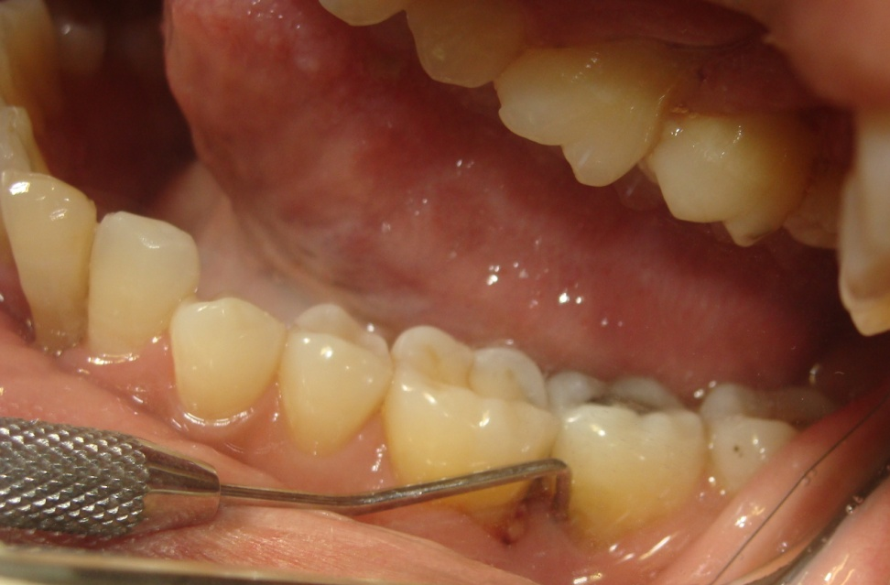
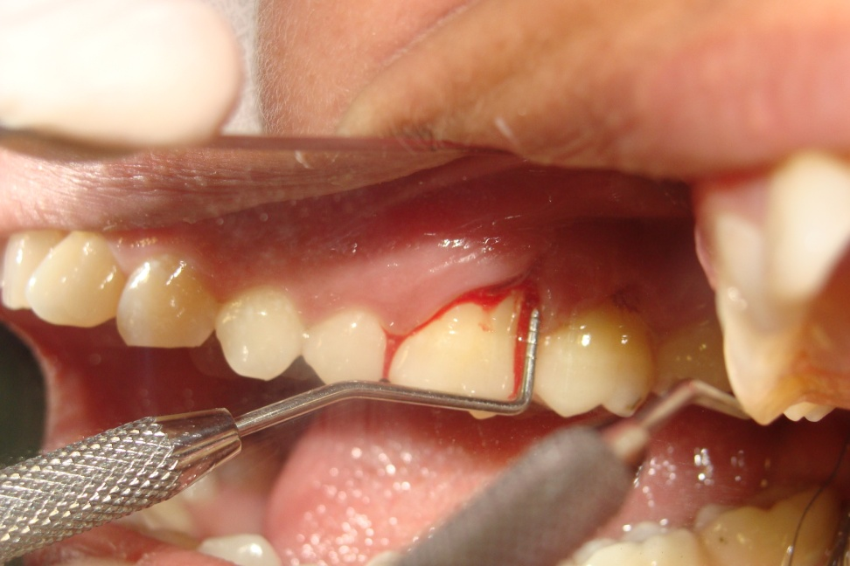

Slide 20
LOCALIZED AGGRESSIVE PERIODONTITIS
RADIOLOGICAL FEATURES...
Vertical loss of alveolar bone around incisors & first molars
Arc-shaped loss of alveolar bone extending from the distal surface of the second premolar to the mesial surface of the second molar
Bone defects usually wider than in chronic periodontitis.

Slide 22
Reasons for limitation of disease to certain teeth:
First molars & incisors….first permanent teeth to erupt….initial colonization by Aa occurs….Aa evades host defenses by different mechanism….. This initial attack…..stimulates production of opsonic antibodies……enhance clearance & phagocytosis of invading bacteria & neutralize leukotoxic activity…..
……..Thus preventing colonization at other sites.

Slide 23
Reasons for limitation of disease to certain teeth:
II. Bacteria antagonistic to Aa colonize the periodontal tissues & inhibit Aa from further colonization of sites.…….Thus localizing the infection & destruction to the initial sites only.
III. Aa may lose its leukotoxin producing ability for some unknown reasons. As a result the disease may become arrested or impaired and colonization of new sites may be averted.

Slide 24
Reasons for limitation of disease to certain teeth:
IV. A defect in the cementum formation may be responsible for the localization of the lesions. Roots surfaces of the teeth extracted from patients with LAP have been found to have hypoplastic or aplastic cementum.
This was seen not only in roots exposed to periodontal pockets but also on roots still surrounded by the periodontium.

Slide 25
Prevalence
Prevalence of LAP in geographically diverse population is less than 1% ..around 0.2% .
Loe et al. 1991
A clinical & radiographic study of English adolescents aged 15 to 19yrs showed a prevalence of 0.1% .
Saxby et al. 1987
A national survey of adolescents in United States, 14 to 17yrs of age showed a prevalence of 0.53%
Loe et al. 1991

Slide 26
GENERALISED AGGRESSIVE PERIODONTITIS
Clinical features....
2 types of gingival tissue responses seen:
Severe , acutely inflamed tissue…often proliferating, ulcerated & fiery red.
Bleeding …..spontaneously or with stimulation.Suppuration…..Occur in destructive stage…..active loss of attachment & bone.

Slide 27
GENERALISED AGGRESSIVE PERIODONTITIS
Clinical features....
Gingival tissues appear pink, free of inflammation, occasionally with some amount of stippling.
Deep pockets….on probing.
Coincides with period of quiescence ....Bone level remains stationary

Slide 28
Prevalence
A study of untreated periodontal disease in Sri Lanka reported a rapid progression of periodontal disease in 8% of population…..characterized by yearly loss of attachment of 0.1 to 1.0 mm.
- Loe et al. 1986
A national survey of adolescents in United States, 14 to 17yrs of age showed a prevalence of 0.13%
- Loe et al. 1991
African americans were at much higher risk of GAP & male teenagers more likely affected than female teenagers.

Slide 29
ETIOPATHOGENESIS OF AGGRESSIVE PERIODONTITIS
Microbiological factors
Immunologic factors
Genetic factors
Environmental factors

Slide 30
Microbiological factors
Several specific micro-organisms have been detected in AP.
Aggregatibacter actinomycetamcomitans
Capnocytophaga spp
Eikenella corrodens
Prevotella intermedia
Campylobacter rectus

Slide 31
According to Tonetti & Mombelli 1999…….
Aa. found in 90% of lesions characteristic of LAP. (Association)
Sites with evidence of disease progression showed elevated levels of Aa.
Patients have significantly elevated serum antibody titers to Aa. (Host Response)
Correaltion between reduction of Aa load & successful clinical response. (Elimination)
Aa. produces a number of virulence factors……contribute to disease progression. (Virulence Factors)

Slide 32
CONTROVERSY........
Aa. could be detected in subgingival plaque samples from sites with and without disease.
There were patients with LAP who apparently neither showed presence of A.a. in the oral flora nor had elevated antibody titers to the organism.
- Loesche et al.1985; Moore 1987.

Slide 33
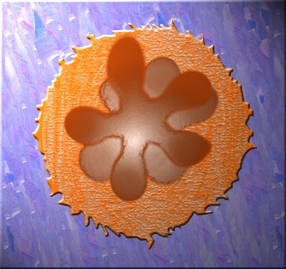
Aggregatibacter (actinobacillus) actinomycetemcomitans
Gram negative facultative non motile rod.
First described by Klinger (1912)
reclassified as Actinobacillus actinomycetemcomitans by Topley & Wilson (1929).
Lauriston and Kilian suggesting the new genus Aggregatibacter for them.

Slide 34
VIRULENCE FACTORS.....
Leukotoxin: destroys human PMN’s and macrophages.
Endotoxin: activates host cells to secrete inflammatory mediators(PGs, IL-1β, TNFα) .
Bacteriocin: may inhibit growth of benefecial species.
Immunosuppressive factors: may inhibit IgG and IgM production.
Collagenases: cause degradation of collagen.
Chemotactic inhibition factor: may inhibit neutrophil chemotaxis.

Slide 35
II. IMMUNOLOGIC FACTORS
PMNs of some LAP and GAP patients present decreased migration and antibacterial functions.
PMN abnormalities in LAP patients…….result of a hyper-inflammatory state resulting in the presence of pro-inflammatory cytokines in the serum of some AP patients.
Approx. 75% of patients with LAP ……..dysfunctional neutrophils……..decreased expression of G-protein coupled receptors.

Slide 36
III. GENETIC FACTORS
AP aggregates in families.
The localized & generalized forms frequently occur in the same families.
Various forms of AP occur in same individuals sequentially.
Suggesting common genetic risk factors for the subforms of AP.

Slide 37
III. ENVIRONMENTAL FACTORS
The amount and duration of smoking are important variables that can influence the extent of destruction seen in young individuals.
Patients with GAP who smoke have more affected teeth and more loss of clinical attachment than nonsmoking patients with GAP.

Slide 38
TREATMENT
Successful treatment of AgP is considered to be dependent on:
Early diagnosis,
Directing therapy towards elimination or suppression of the infecting microorganisms and
Providing an environment conducive to long-term maintenance.

Slide 39
Therapeutic modalities….
To alter or eliminate the microbial etiology and contributing risk factors for periodontitis.
Arrest/slowdown the progression of disease.
Preserving the dentition in comfort, function, and appropriate esthetics and to prevent the recurrence of disease.
Regeneration of the periodontal attachment apparatus.

Slide 40
Conventional periodontal therapy....
Patient education
Oral hygiene improvement
Scaling & root planing
Regular recall maintenance
May or may not include flap surgery

Slide 41
Surgical periodontal therapy....
Treatment of deep periodontal pockets & bone loss may be done via surgical approach.
Surgery may be
Purely resective
Regenerative
Combination of above.

Slide 42
Antimicrobial therapy......
The presence of Aa. has been implicated as reason that AgP does not respond to conventional treatment.
Reason…….capacity of the cell to penetrate tissues…..reinfect the pocket after conventional therapy.
Thus, the use of antibiotics was thought to be necessary to eliminate pathogenic bacteria from the tissues.

Slide 43
Antimicrobial therapy......
Mainly Tetracycline(250 mg four times daily for 14 days every 8 weeks) & its derivatives are used.
Systemic Antibiotics should only be administered as an adjunct to mechanical debridement.
Mechanical therapy + Meticulous oral hygiene
Clinically re-assessed after 4-6 wks
Decision made to gain to deep lesions(surgery) & Antibiotic selection depending on culture sensitivity tests.

Slide 44
FULL MOUTH DISINFECTION
Quirynen et al in 1995 …..
Consists of:
Full mouth debridement in 2 appointments within 24 hrs.
Brushing of tongue for 1 min with 1% CHX gel
Rinsing of mouth for 2 mins with 0.2% CHX soln.
Irrigation of periodontal pockets with 1% CHX soln.

Slide 45
HOST MODULATION
A novel approach in the treatment of aggressive periodontitis and difficult-to-control forms of periodontal disease is the administration of agents that modulate the host response. Several agents have been used or evaluated to modify the host response to disease .

Slide 46
HOST MODULATION
The use of subantimicrobial-dose doxycycline (SDD) may help to prevent the destruction of the periodontal attachment by controlling the activation of matrix metalloproteinases, primarily collagenase and gelatinase, from both infiltrating cells and resident cells of the periodontium, primarily the neutrophils.
Other agents such as non-steroidal anti-inflammatory drugs …..flurbiprofen, indomethacin, naproxen may reduce inflammatory mediator production.

Slide 47
Successful management of patients with aggressive periodontitis must include tooth replacement as part of the treatment plan
In the patient with aggressive periodontitis, the approach to restorative treatment should be made based on a single premise: extract severely compromised teeth early, and plan treatment to accommodate future tooth loss.
The teeth with the best prognosis should be identified and considered when planning the restorative treatment.

Slide 48
SUMMARY
Aggressive periodontitis is a challenge for the clinician because it is infrequently encountered and the predictability of treatment success varies from one patient to another.
These unusual entities often do not respond well to conventional therapy owing to the complex nature of the disease.

Slide 49
REFERENCES
Newman MG, Takei HH, Klokkevold PR, Carranza FA. Carranza’s clinical periodontology, 10th ed. Saunders Elsevier; 2007.
Lindhe J, Lang NP and Karring T. Clinical Periodontology and Implant Dentistry. 6th ed. Oxford (UK): Blackwell Publishing Ltd.; 2015.
Newman MG, Takei HH, Klokkevold PR, Carranza FA. Carranza’s clinical periodontology, 13th ed. Saunders Elsevier; 2018.

